Slide 1
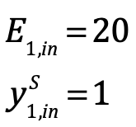
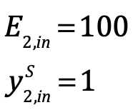
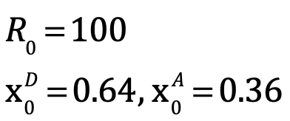
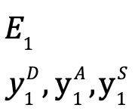
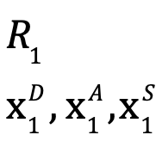
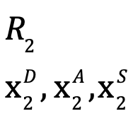
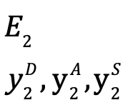
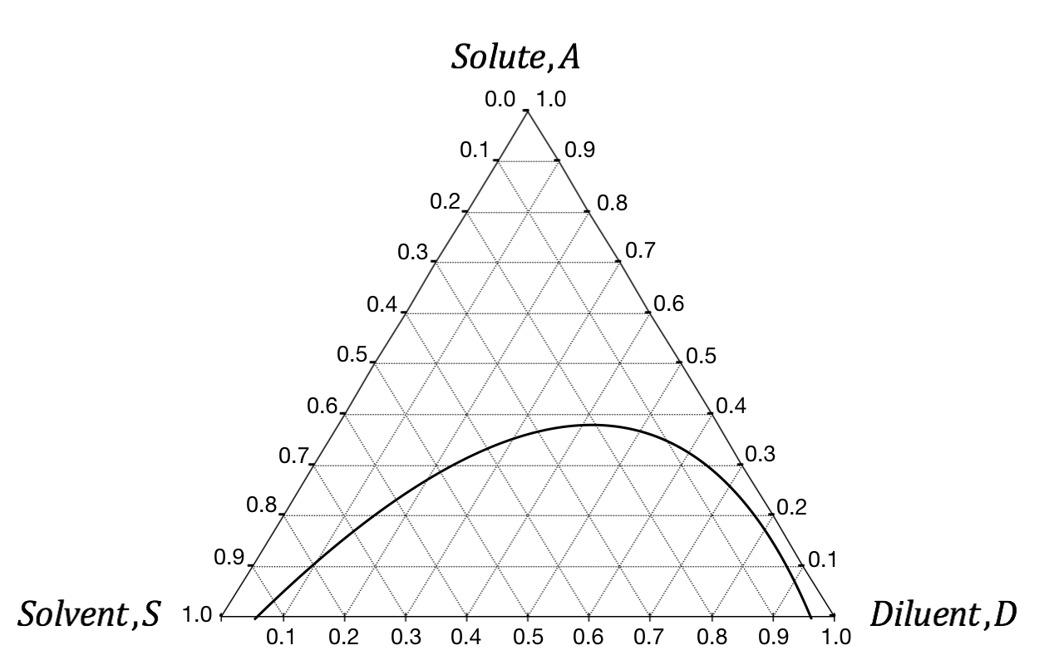
Exercise problem 1: two-stage cross-flow
Calculate
Stage 1
Stage 2
Feed

Slide 2
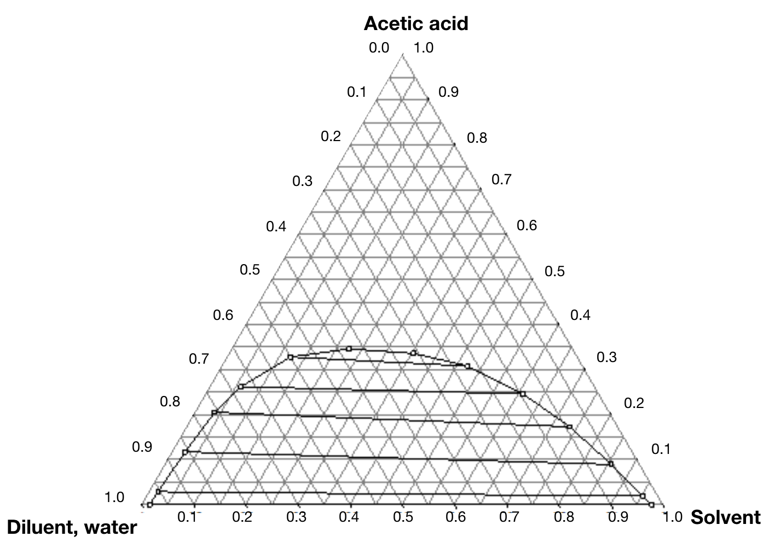
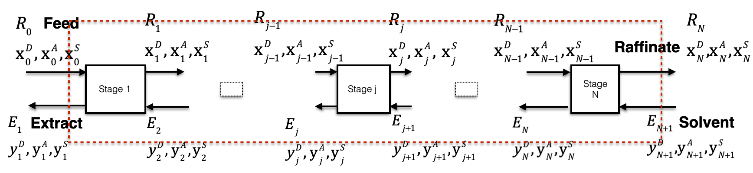
Exercise problem 2: countercurrent operation
A solution of acetic acid (A) in water (D) is to be extracted using a solvent (S). 1000 kg/h of a feed containing 35 wt% acetic acid and 65 wt% water is fed to a countercurrent extractor. Solvent is from a solvent recovery plant and is essentially pure isopropyl ether. Inlet solvent flow rate is 2000 kg/h. Exiting raffinate stream should contain 10 wt% acetic acid. Find outlet concentrations and number of equilibrium stages required.

